Slide 1
Physical Layer

Slide 2
Physical Layer
The Physical Layer is the lowest OSI layer responsible for transmitting raw data bits through physical network hardware.
Handles physical and electrical data transmission
Includes cables, connectors, plugs, and receivers
Transfers raw bits between devices
Defines hardware standards and signal types

Slide 3
Functions of Physical Layer
The Physical Layer is responsible for sending raw data as bits over a physical medium.
It converts data into signals that can travel through wires, fiber optics, or wireless channels (encoding) and turns these signals back into data at the receiver (decoding).
It ensures signals are transmitted correctly and uses techniques like modulation to prepare the data for transmission and demodulation to retrieve it at the other end.
This layer also decides how data flows (one-way, two-way alternately, or simultaneously) through transmission modes and controls the speed and timing of data transmission to keep everything running smoothly.

Slide 4
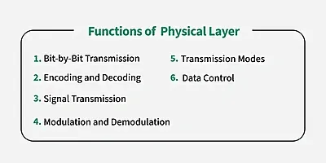
Functions of Physical Layer

Slide 5
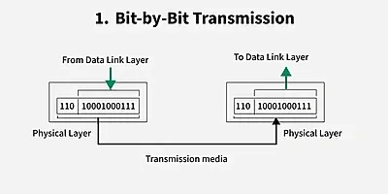
Bit-by-Bit Transmision

Slide 6
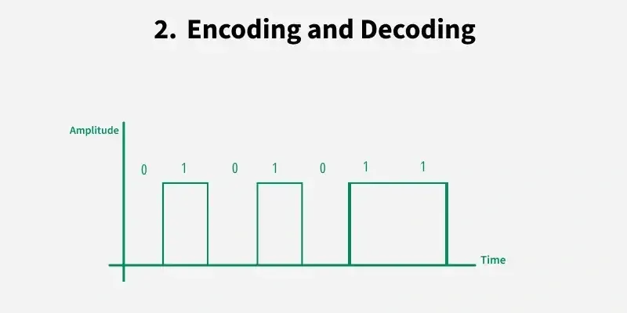
Encoding and decoding

Slide 7
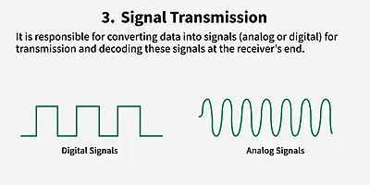
Signal Transmission

Slide 8
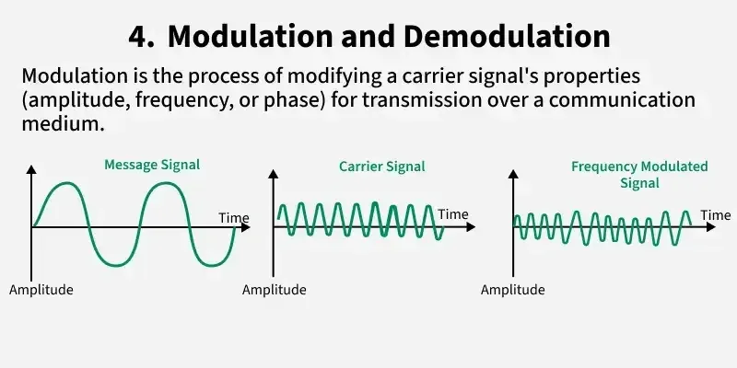
Modulation and Demodulation

Slide 9
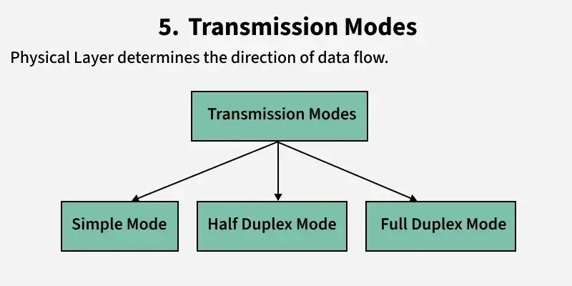
Trasmission Modes

Slide 10
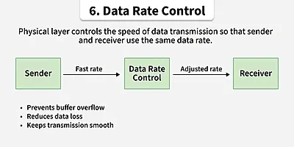
Data Rate Controls

Slide 11
Trasmission Media
Transmission media refers to the physical or wireless communication channel used to carry data signals from one device to another within a computer network.
It forms the fundamental pathway through which information is transmitted, ensuring connectivity between networked devices.

Slide 12
Selection of Transmision Medium
The selection of a transmission medium depends on factors such as:
Transmission distance
Data transfer speed (bandwidth)
Susceptibility to interference and noise
Cost and installation requirements

Slide 13
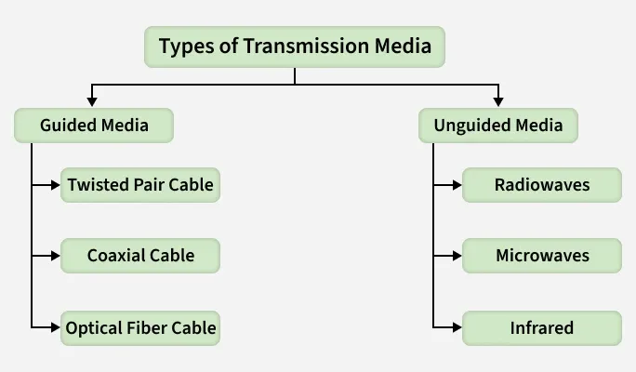
Types of Transmision Media
Based on the nature of the transmission path, transmission media are broadly classified into two main types:

Slide 14
Guided Media
Guided Media also known as wired or bounded transmission media, refers to transmission media in which data signals are transmitted through a physical path using cables. The signal is confined and guided along a fixed route, providing controlled communication between network devices.
Uses physical cables to transmit data signals.
Provides dedicated and well-defined transmission paths.
Major types of guided media included Twisted Pair Cables, Coaxial Cables and Optical Fiber Cables.
Offers higher data transmission rates compared to most wireless media.
Provides better security due to physical connectivity and limited signal leakage.
Suitable for short to long-distance communication, depending on the cable type used.

Slide 15
Twisted Pair Cable
A twisted pair cable consists of two individually insulated copper conductors twisted together in a helical pattern to minimize electromagnetic interference (EMI) and crosstalk between adjacent pairs.
Multiple twisted pairs are typically enclosed within a protective outer sheath, making this cable one of the most commonly used and cost-effective guided transmission media.
Twisting of conductors helps reduce interference and signal degradation.
Multiple pairs can be bundled together within a single cable.
Widely used due to low cost, flexibility, and ease of installation.
Commonly used in telephone systems and local area networks (LANs).

Slide 16
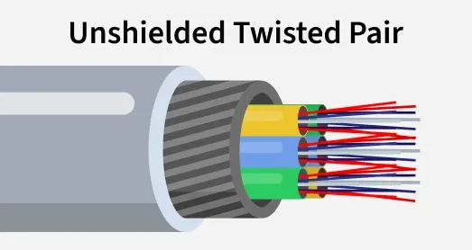
Unshielded Twisted Pair (UTP)
UTP cable consists of twisted copper wire pairs without any additional metallic shielding. The twisting provides basic protection against interference, making UTP suitable for environments with moderate noise levels.

Slide 17
Advantages:
Least expensive among guided transmission media.
Easy to install and maintain due to its lightweight and flexible nature.
Supports high data transmission rates over short distances.
Widely used in Ethernet-based LANs and telephone networks.

Slide 18
Disadvantages
Lower performance and capacity compared to Shielded Twisted Pair (STP).
Limited transmission distance due to signal attenuation.
More susceptible to noise and electromagnetic interference.

Slide 19
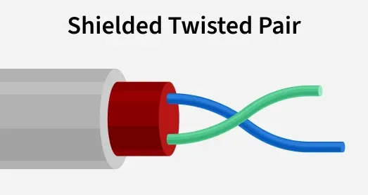
Shielded Twisted Pair (STP):
Shielded Twisted Pair (STP) cable consists of twisted pairs of insulated copper conductors enclosed within an additional metallic shielding layer, such as a foil or braided shield.
This shielding provides enhanced protection against external electromagnetic interference (EMI) and reduces crosstalk, resulting in more stable and reliable data transmission.

Slide 20
Advantages
Provides better performance at higher data transmission rates compared to UTP.
Significantly reduces electromagnetic interference and crosstalk.
Ensures more reliable and stable communication, especially in noisy environments.
Suitable for high-speed Ethernet networks and voice and data transmission systems.

Slide 21
Disadvantages
Higher cost compared to Unshielded Twisted Pair (UTP).
More complex installation and termination due to shielding requirements.
Bulkier and less flexible, making cable management more difficult.

Slide 22
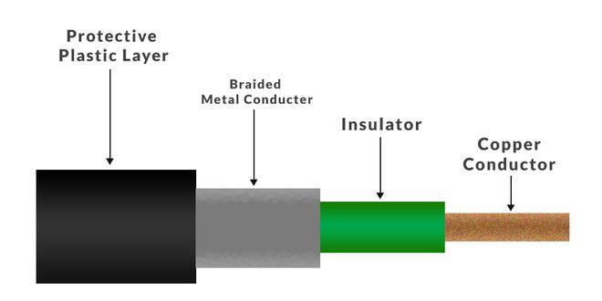
Coaxial Cable
Coaxial Cable consists of a central copper conductor surrounded by a dielectric insulating layer, a metallic shielding layer, and an outer protective jacket. This structure allows signals to be transmitted with better protection against noise and interference compared to twisted pair cables.
Supports data transmission in both baseband mode (single channel) and broadband mode (multiple channels).
Provides higher bandwidth than twisted pair cables.
Strong shielding makes it more resistant to noise, crosstalk, and electromagnetic interference (EMI).
Commonly used in cable television (CATV), broadband networks, and analog television systems.
More durable and reliable due to its layered construction.
Easier to install and maintain compared to optical fiber cables.

Slide 23
Advantages
Supports higher bandwidth than twisted pair cables.
Offers better signal quality and reliability.
Allows multiple channels using frequency division multiplexing (FDM).
Less affected by external electromagnetic interference.

Slide 24
Disadvantages
More expensive than twisted pair cables.
Requires proper grounding to ensure safety and minimize interference.
Bulkier and less flexible due to multiple layers.
More vulnerable to security breaches, as the cable can be physically tapped.

Slide 25
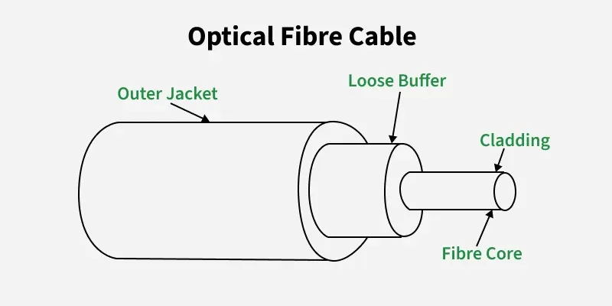
Optical Fiber Cable
Optical Fiber Cable is a guided transmission medium that transmits data in the form of light signals through a glass or plastic core using the principle of total internal reflection. The core is surrounded by a cladding layer with a lower refractive index, which confines the light within the core and enables high-speed, long-distance data transmission.
Supports very large data volumes at extremely high speeds.
Can operate in unidirectional or bidirectional communication modes.
WDM (Wavelength Division Multiplexer) allows multiple light signals to be transmitted simultaneously over a single fiber.
Widely used where high bandwidth, long distance, and low signal loss are required.

Slide 26
Advantages
Provides very high bandwidth and data-carrying capacity.
Lightweight and compact, making installation easier over long distances.
Exhibits low signal attenuation, suitable for long-distance communication.
Immune to electromagnetic interference (EMI) and electrical noise.
Resistant to corrosion and harsh environmental conditions.

Slide 27
Disadvantages
Complex installation and maintenance due to precise splicing and handling requirements.
High initial installation and equipment cost.
Fragile compared to copper cables and requires careful handling.

Slide 28
Applications
Medical: Used in endoscopy, imaging systems, and laser-based surgical procedures.
Defense and Aerospace: Supports secure, high-speed, and interference-free communication.
Communication: Widely used in internet backbone networks, undersea cables, and telecommunication systems.
Industrial and Automotive: Used for sensing, lighting, data communication, and safety systems.

Slide 29
Unguided Media
Unguided media, also known as wireless or Unbounded transmission media , uses electromagnetic waves to transmit data without any physical medium.
Signals propagate through free space such as air or vacuum.
The main types of unguided media are:
Radio waves,
microwaves,
infrared waves.
Features:
Signals propagate through air or free space
Less secure due to broadcast nature
Suitable for long-distance communication

Slide 30
Radio Waves
Radio waves are a type of electromagnetic wave that can easily be generated and can propagate through buildings and other obstacles.
They do not require line-of-sight between transmitting and receiving antennas, making them highly suitable for broadcast communication and wireless data transmission
Frequency Range: 3 kHz – 300 GHz
Applications: AM and FM radio broadcasting, television transmission, cordless phones, and wireless communication.
Types of Radio Waves:
Shortwave: AM radio broadcasting
VHF (Very High Frequency): FM radio and television
UHF (Ultra High Frequency): Television and mobile communication
Components:
Transmitter: Generates and modulates the signal
Receiver: Receives and demodulates the signal

Slide 31
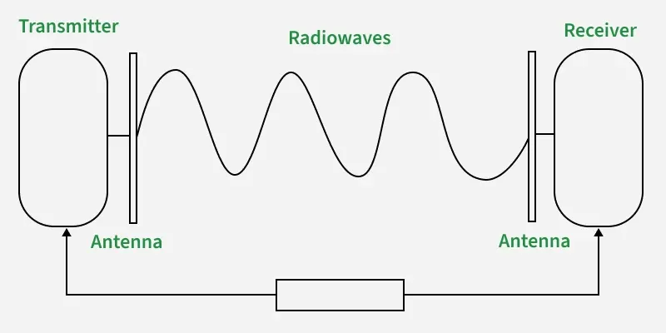
Radiowave

Slide 32
Microwaves
Micro waves are a form of unguided transmission media that use line-of-sight communication, where the transmitting and receiving antennas must be properly aligned.
The transmission range depends on the height of the antennas.
Microwaves operate in the frequency range of 1 GHz to 300 GHz and are widely used in mobile communication, satellite links, and television distribution.

Slide 33
Advantages & Disadvantages
Advantages:
Cost-effective compared to laying physical cables
No need for land acquisition
Suitable for communication over difficult terrains and oceans
Supports high data transmission rates
Disadvantages:
Less secure without proper encryption
Susceptible to weather conditions such as rain and fog
Affected by obstacles due to line-of-sight requirement
High cost of antenna design, installation, and maintenance

Slide 34
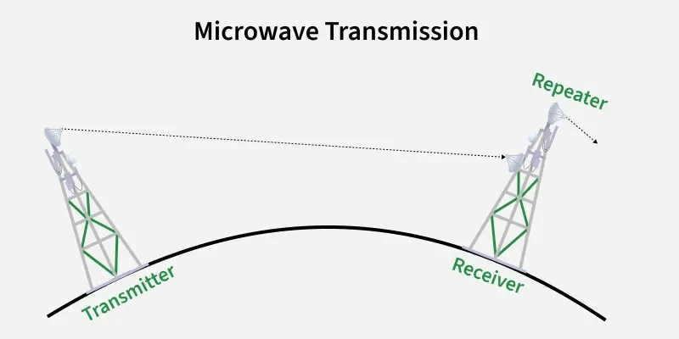
Microwave Transmission

Slide 35
Infrared
Infrared waves are used for short-range wireless communication and operate in the frequency range of 300 GHz to 400 THz.
They cannot penetrate solid obstacles, which limits their range but helps minimize interference between nearby systems.
Infrared waves are commonly used in TV remote controls, wireless keyboards, mice, and printers.

Slide 36
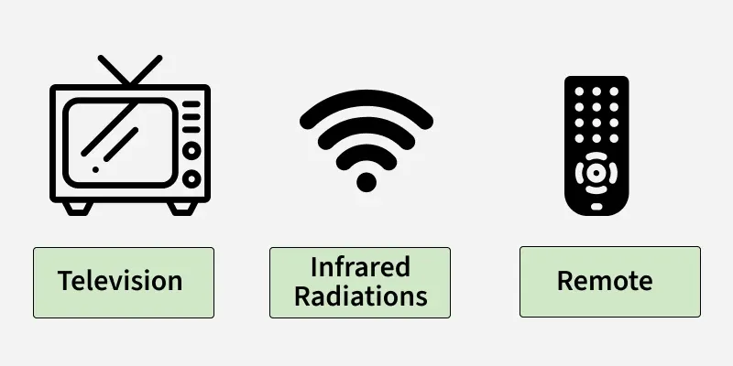
Infrared waves

Slide 37
Difference Between Radio Waves, Micro Waves, and Infrared Waves
Radio Waves | Microwaves | Infrared Waves
Omnidirectional in nature | Highly directional | Directional, requires line of sight (LOS)
Can penetrate buildings and obstacles easily due to low frequency | Poor penetration; line of sight required | Cannot penetrate obstacles
Frequency range: 3 kHz – 300 GHz | Frequency range: 1 GHz – 300 GHz | Frequency range: 300 GHz – 400 THz
Low security | Medium security (encryption possible) | Relatively high security but limited range
Moderate attenuation | Variable attenuation, depends on weather conditions | High attenuation
Some frequency bands require government licensing | Most frequency bands are licensed by the government | Generally unlicensed
Low to moderate cost | High cost | Low cost
Supports long-distance communication | Supports long-distance communication | Suitable only for very short-distance communication

Slide 38
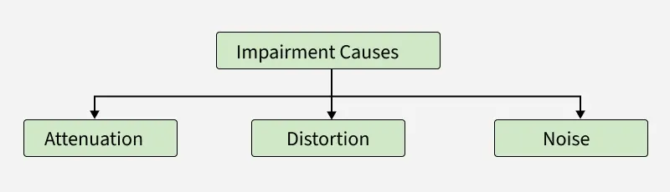
Causes of Transmission Impairment
Transmission impairment refers to the loss or distortion of signals during data transmission, leading to errors or reduced quality in communication. Common causes include signal distortion, attenuation, and noise all of which can affect the clarity and reliability of transmitted data.

Slide 39
Causes of Transmission Impairment
Attenuation: Loss of signal strength as the signal propagates over a transmission medium due to resistance and energy loss. In analog systems, amplifiers are used to increase signal strength, while in digital communication, repeaters or regenerators are used to restore the original signal.
Distortion: Occurs when the shape of the transmitted signal changes. This typically happens in composite signals where different frequency components travel at different speeds, causing phase shifts and timing differences at the receiver.
Noise: It refers to unwanted electrical or electromagnetic signals that interfere with the original signal, potentially corrupting data. Common types of noise include thermal noise, induced noise, crosstalk, impulse noise.

Slide 40
Factors Considered for Designing the Transmission Media
Bandwidth: It refers to the range of frequencies that a transmission medium can support.
Higher bandwidth allows higher data transmission rates, assuming other factors such as noise and attenuation remain constant.
Transmission Impairment : Transmission Impairment occurs when the received signal differs from the transmitted signal. Signal quality will be impacted as a result of transmission impairment.
Interference: It is the disturbance of a signal caused by the addition of unwanted signals from external sources such as electromagnetic radiation or neighboring channels. It degrades signal clarity and may result in data corruption.

Slide 41
Applications of Transmission Media in Computer Networks
Transmission Media | Application
Unshielded Twisted Pair (UTP) | Local Area Networks (LAN), telephones
Shielded Twisted Pair (STP) | Industrial networks, environments with high interference
Optical Fiber Cable | Long-distance communication, internet backbones
Coaxial Cable | Cable TV, broadband internet, CCTV
Radio | Wireless communication, AM/FM radio, mobile phones
Infrared | Remote controls, short-range communication
Microwave | Satellite communication, radar, long-distance links

Slide 42
The Data Link Layer

Slide 43
Data Link Layer
The data link layer is the second layer from the bottom in the OSI network architecture model.
The major functions of the Data Link Layer include framing, physical addressing, error detection, flow control, and media access control.
It organizes data into frames and provides node-to-node delivery over a physical link.
It also provides an interface between the Network Layer and the Physical Layer.

Slide 44
Sub-Layers of The Data Link Layer
The data link layer is further divided into two sub-layers, which are as follows:
1. Logical Link Control (LLC): This sublayer provides services to the Network Layer and handles functions such as multiplexing, flow control, error control, and acknowledgments, depending on the LLC service used.
Protocol Identification: Identifies which network layer protocol (such as IP) is being used and ensures correct delivery of data.
Flow Control: Regulates the rate of data transmission to prevent data overflow between sender and receiver.
Error Control: Detects transmission errors and may request retransmission of corrupted frames.
2. Media Access Control (MAC): This is the lower sub-layer of the Data Link Layer responsible for controlling how devices access the physical transmission medium. It handles physical addressing and ensures that data is transmitted efficiently without conflicts on the network.
Physical Addressing: Adds MAC address to frames to uniquely identify sender and receiver devices.
Media Access Management: Controls when a device can send data to avoid collisions in shared communication channels.
Frame Transmission: Encapsulates packets received from the Network Layer into frames and passes them to the Physical Layer for transmission.

Slide 45
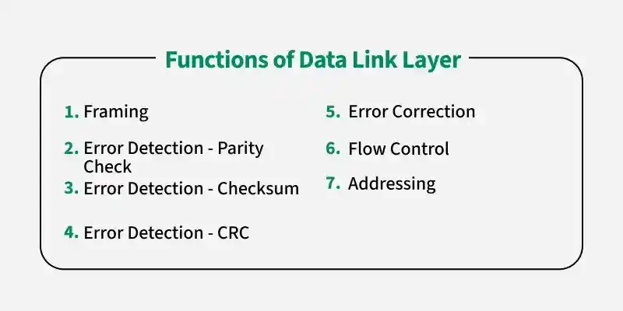
Functions of DLL

Slide 46
Types of Errors
When ever bits flow from one point to another, they are subject to unpredictable changes because of interference.
This interference can change the shape of the signal.
Different Types of Errors Exist:
Single-Bit Error
Burst Error

Slide 47
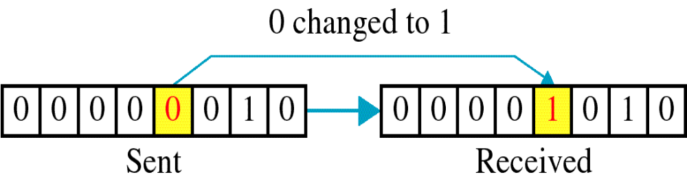
Single-Bit Error
The term single-bit error means that only 1 bit of a given data unit (such as a byte, character, or packet) is changed from 1 to 0 or from 0 to 1.

Slide 48
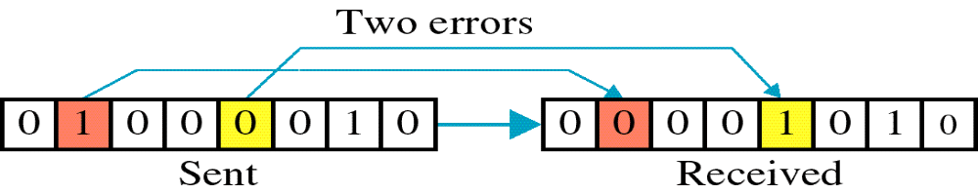
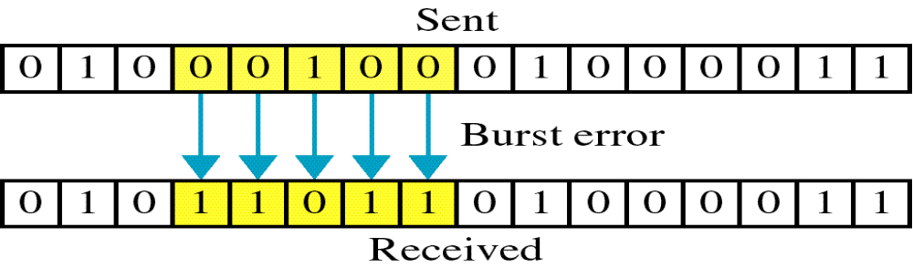
Burst Error
The term burst error means that 2 or more bits in the data unit have changed from 1 to 0 Or from 0 to 1.

Slide 49
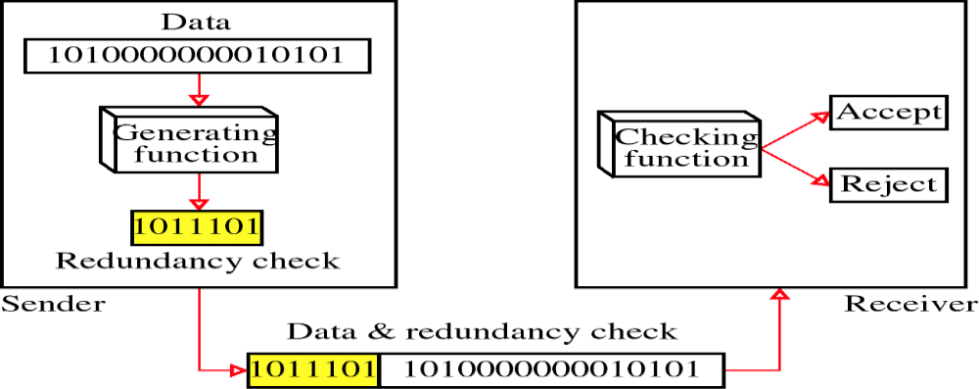
Redundancy
The central concept in detecting or correcting errors is redundancy.
To be able to detect or correct errors, we need to send some extra bits with our data.
These redundant bits are added by the sender and removed by the receiver.
Their presence allows the receiver to detect or correct corrupted bits.

Slide 50
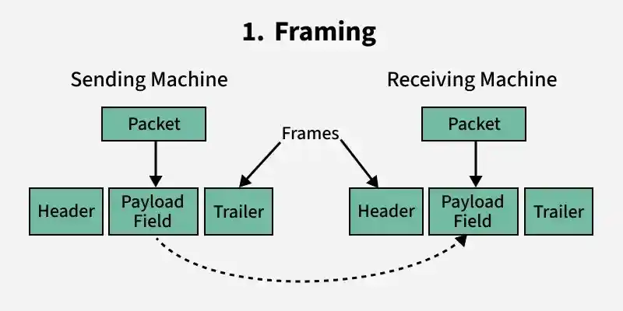
Framing

Slide 51
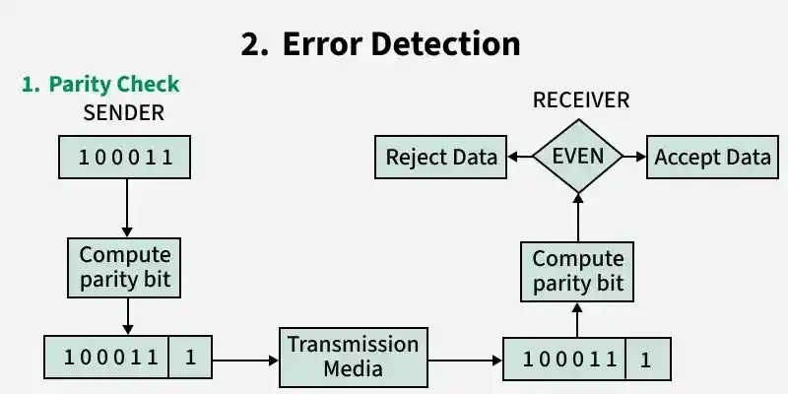
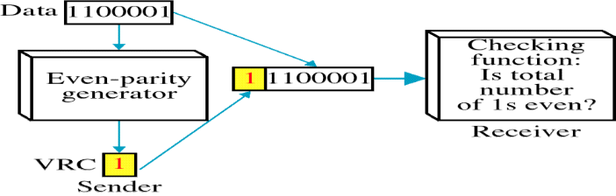
Error Detection-Parity Check
Perhaps the most familiar error-detecting code is the VRC (Parity Bit Method).
In this code, a k-bit dataword is changed to an n-bit codeword where n= k+ 1.
The extra bit, called the parity bit, is selected to make the total number of Is in the codeword even.

Slide 52
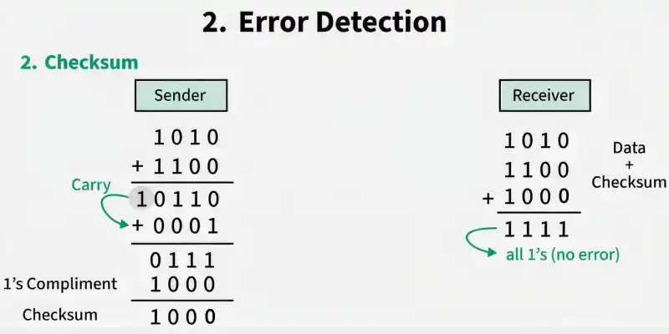
Error Detection-Checksum
Suppose our data is a list of five 4-bit numbers that we want to send to a destination.
In addition to sending these numbers, we send the sum of the numbers.
For example, if the set of numbers is (7, 11, 12, 0, 6), we send (7, 11, 12,0,6,36), where 36 is the sum of the original numbers.
The receiver adds the five numbers and compares the result with the sum.
If the two are the same, the receiver assumes no error, accepts the five numbers, and discards the sum. Otherwise, there is an error somewhere and the data are not accepted.

Slide 53
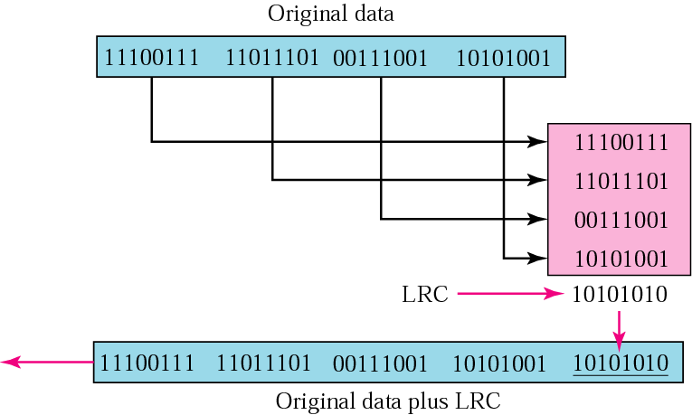
LRC
In Longitudinal redundancy check (LRC),a block of bits is organized in a table(rows and columns).
Then calculate the parity bit for each column and create a new row of 8 bits, which are the parity bits for the whole block.
First parity bit in the fifth row is calculated based on all first bits, and so on.
Then attach the 8 parity bits to the original data and send them to the receiver.

Slide 54
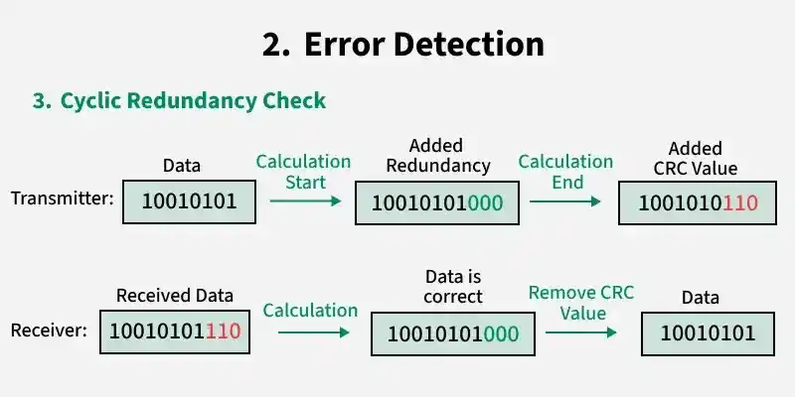
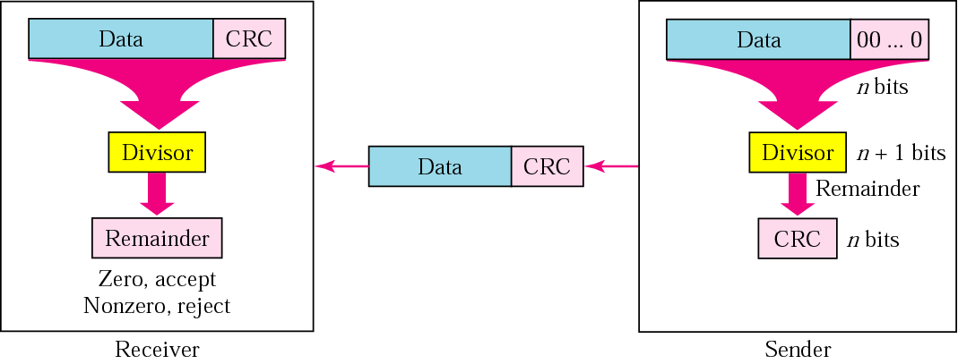
Error Detection-Cyclic Redundacy Check
The most powerful of the redundancy checking techniques is the cyclic redundancy check (CRC).
Unlike VRC and LRC, which are based on addition, CRC is based on binary division.
Instead of adding bits together to achieve a desired parity ,a sequence of redundant bits, called the CRC or the CRC remainder, is appended to the end of a data unit so that the resulting data unit becomes exactly divisible by a second, predetermined binary number.
A remainder indicates that the data unit has been damaged in transit and therefore must be rejected.

Slide 55
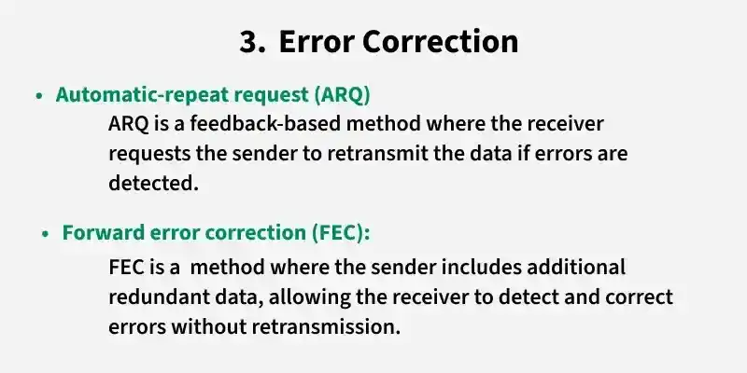
Error Correction-ARQ & FEC
Two methods:
  Sender-based: First error detection, then ask sender to retransmit data in case of an error.
  Automatic or Receiver-based: Here, receiver tries to find out after an error what the correct data might have been.
  → Error-correcting codes (i.e, Hamming code)
In theory, it is possible to correct any detected error automatically, however, this is not done in practice, because it requires lots of redundancy (which is overhead).

Slide 56
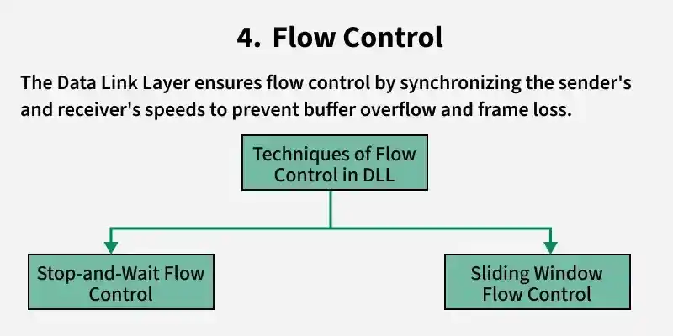
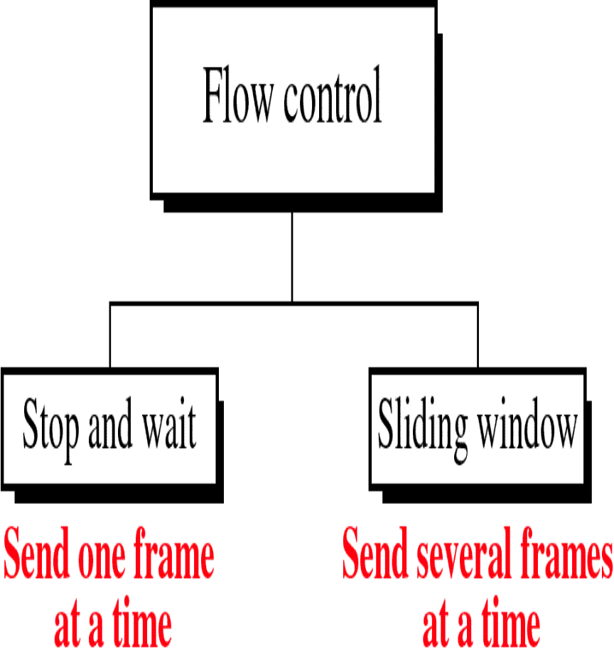
Flow Control

Slide 57
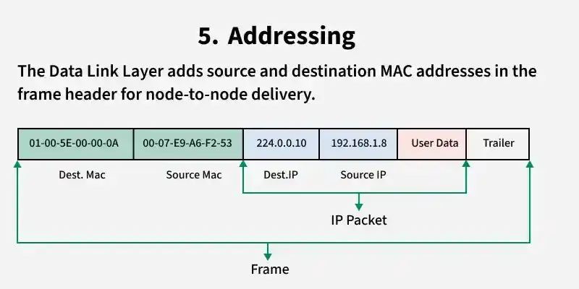
Addressing

Slide 58
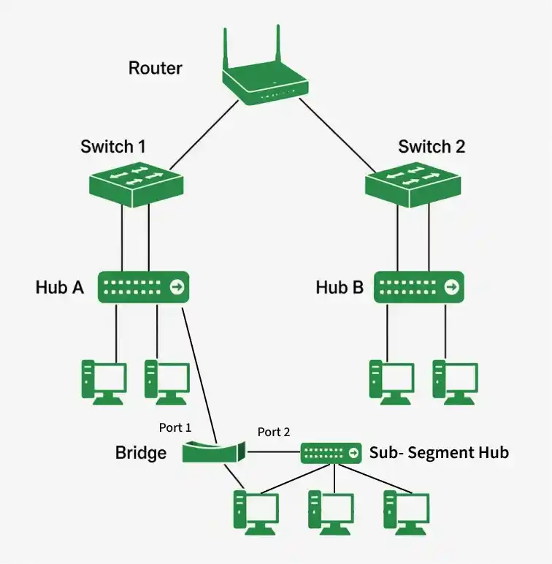
Devices Operating at the Data Link Layer

Slide 59
Assignment on Physical Layer (Group 1)
In a group of two prepare a presentation on:
Modems and RS232 Interfacing sequences
Line coding and it’s techniques.

Slide 60
Assignment on Physical Layer (Group 2)
In a group of two prepare a presentation on:
Serial Line Interface Protocol (SLIP)
Point to Point Protocol (PPP)
Link Access Procedure (LAP)

Slide 61
Assignment on on Data Link Layer (Group3)
In the same group of two prepare a presentation on:
Synchronous Data Link Protocol (SDLC)
High-Level Data Link Control (HDLC)

Slide 62
Assignment on on Data Link Layer (Group 4)
In the same group of two prepare a presentation on:
Link Control Protocol (LCP)
Network Control Protocol (NCP)

